Slide 1
HR Portal

Slide 2
Technologies use
Html
Css
JavaScript
Bootstrap
Node JS
React JS

Slide 3
First create angular project using
Install node js
Check node js version using command as node --version
Check npm command version using command as npm --version
Then install ng command using npm install –g create-react-app
Then create the project using command as
create-react-app react-hr-portal

Slide 4
To run the project
Please move inside this project ie react-hr-portal
Run npm install to download all dependencies
Before start the project please run the json file using command as
using command as json-server hr.json file

Slide 5
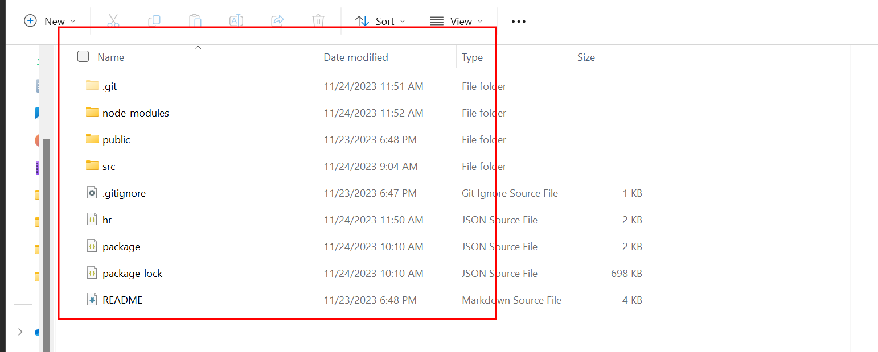
json-server hr.json file

Slide 6
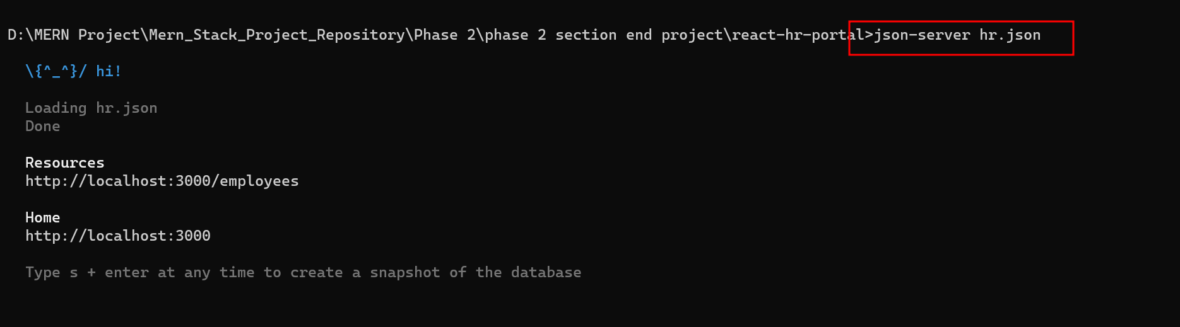

Slide 7
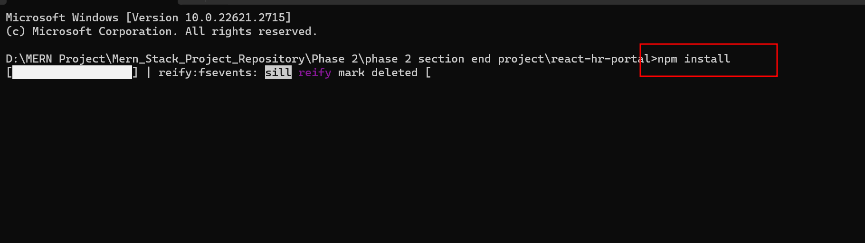
Now we need to install required dependencies
Move inside a project folder and install below dependencies
npm install
Which help to download required dependencies.

Slide 8
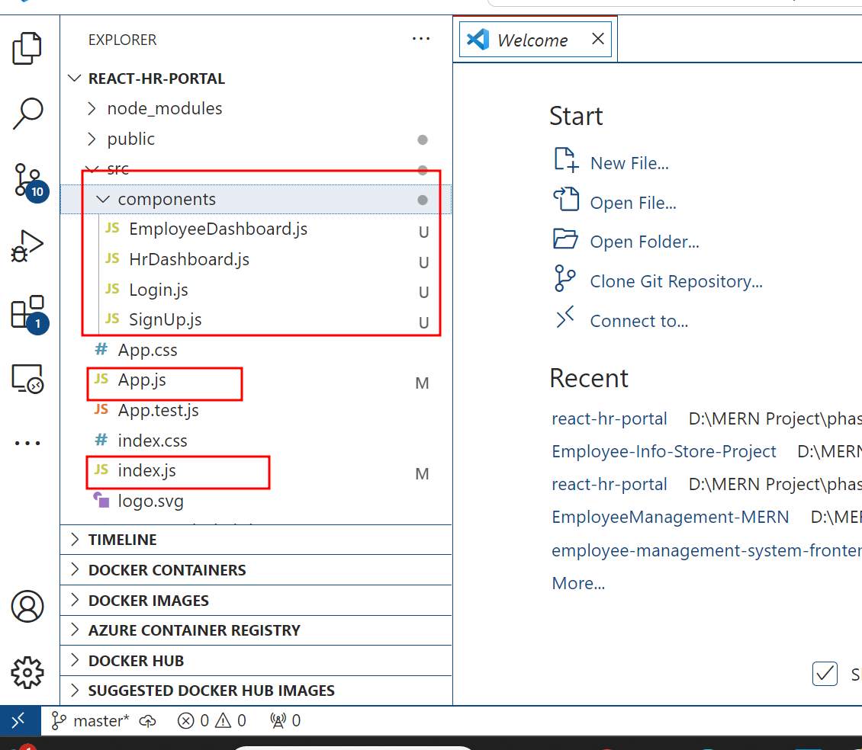
The project structure
Open the project in VS Code

Slide 9
Short description
component created :
App.js
Login.js
SignUp.js
HrDashboard.js
EmployeeDashboard.js
jsondata
hr.json
css
App.css

Slide 10
To run the project
First run the command as npm install inside a :react-hr-portal.
Then run the command as npm start to run the project.
After compiled program successfully open the browser and write the URL as http://localhost:3001

Slide 11
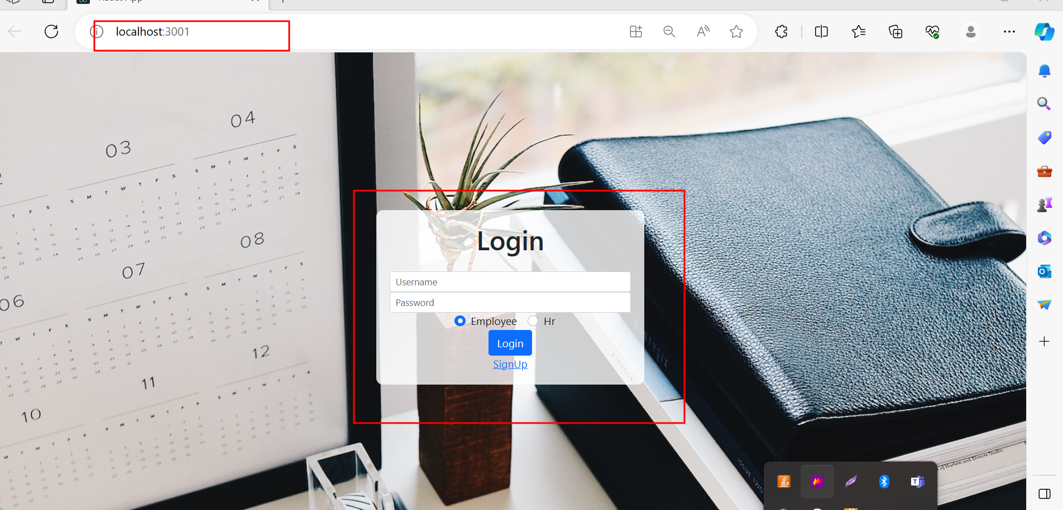

Slide 12
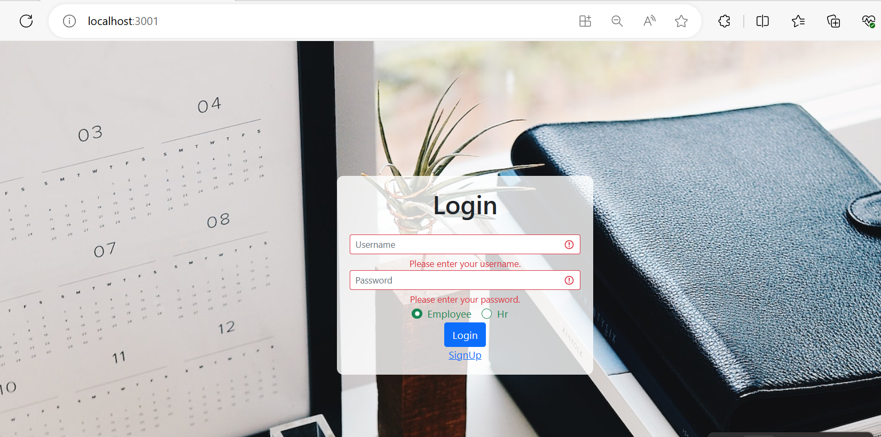
If you not write details you will get error message.

Slide 13
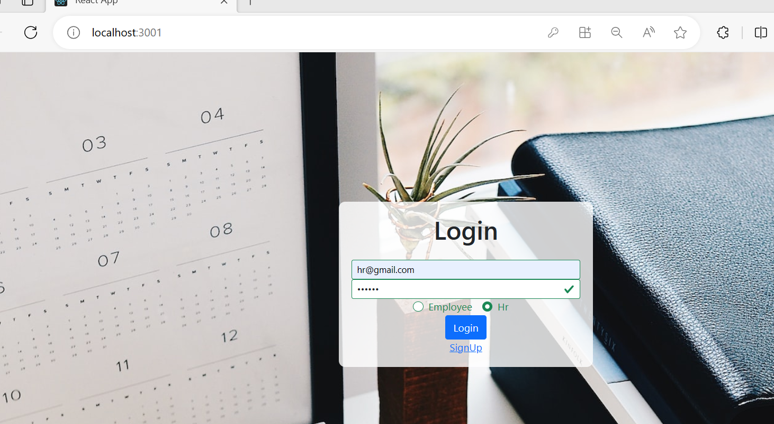
Login hr login with emailId as hr@gmail.com and password as hr@123.

Slide 14
HR Functionality
Hr can login using email id and password ie hr@gmail.com and password as hr@123
Hr can view all employee details.
Hr can add employee with information as name, emailId, andn departmentname.
Hr can approved or reject the leave applied by employee.

Slide 15
Employee functionality
Employee can do signup.
Employee can create account only after hr added his or her emalid id information in json file.
If valid emaild present then only employee can add remaining details like lastname, gender, phone number, address etc
Hr can apply for leave
Hr can view the leave information

Slide 16
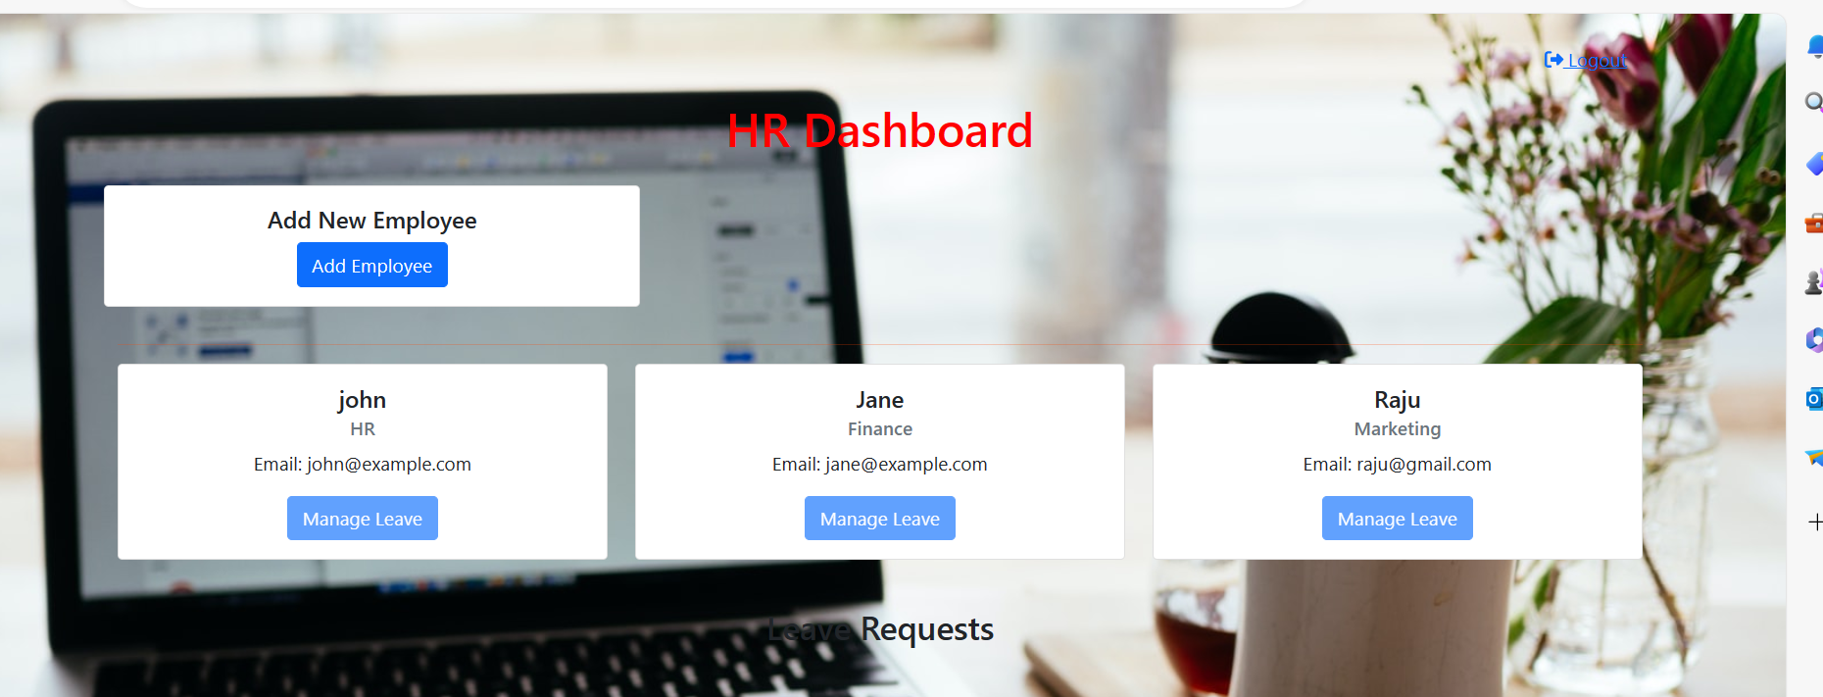
Hr dashboard

Slide 17
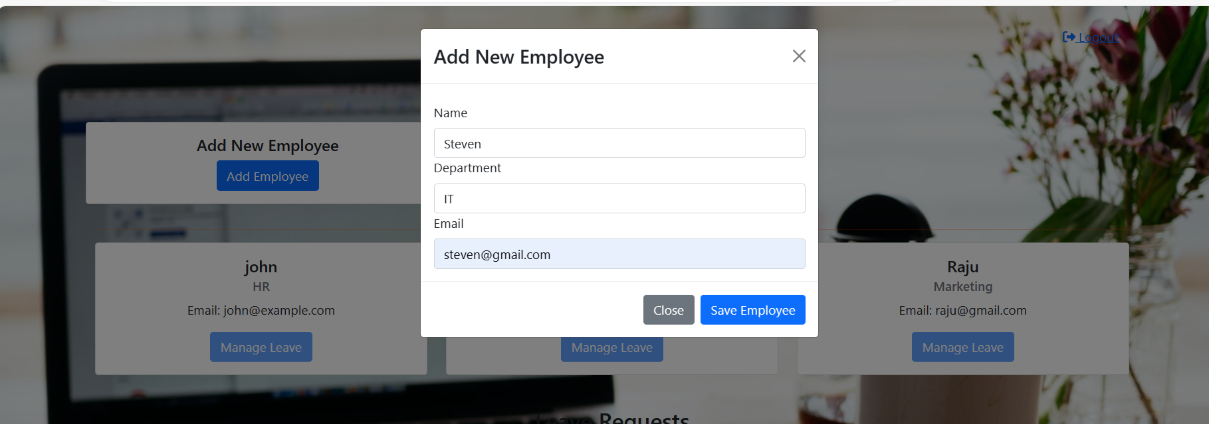
HR can add employee

Slide 18
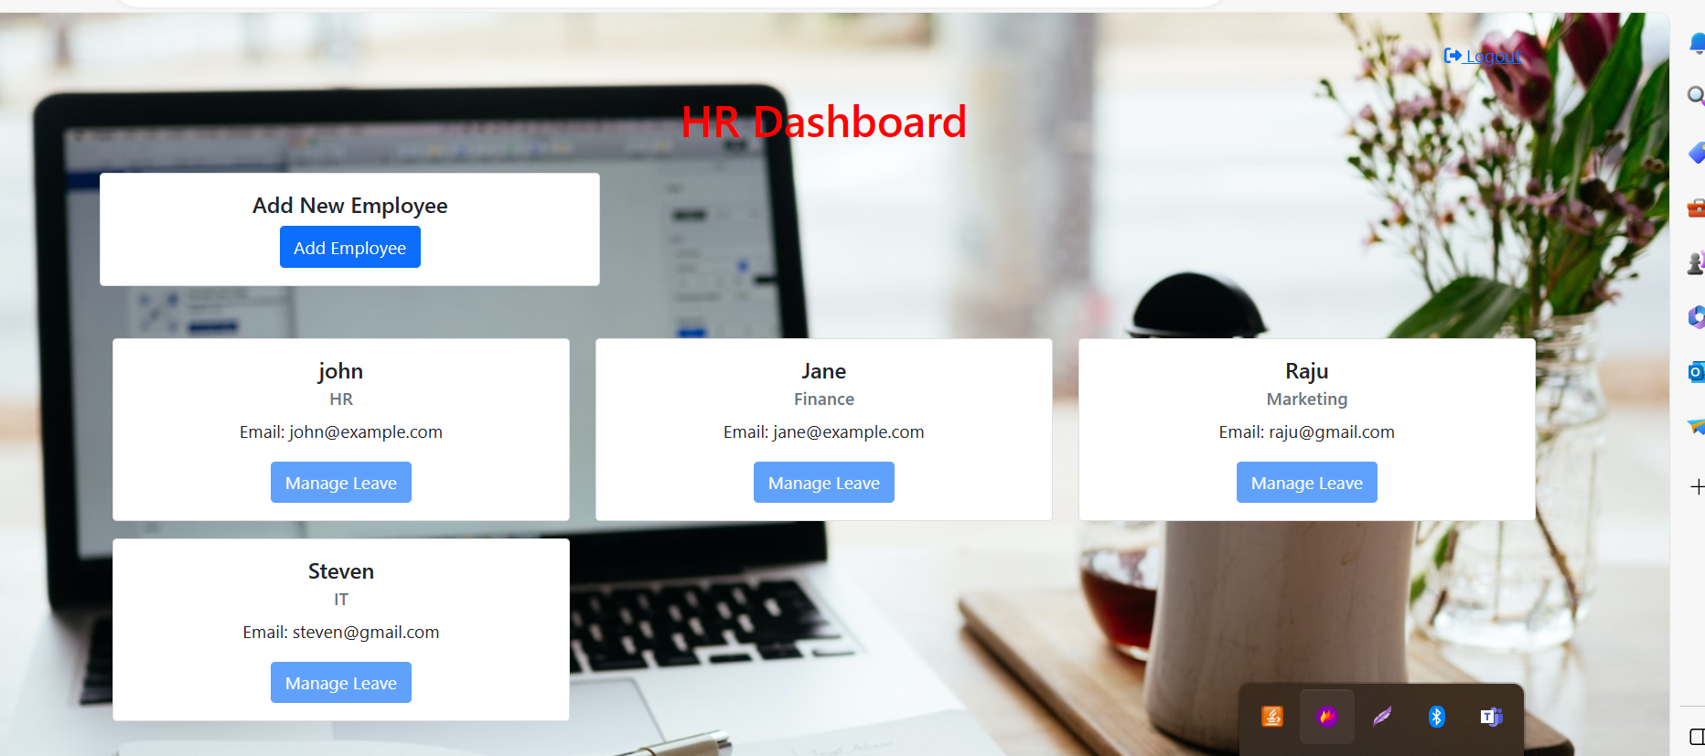
After added employee hr can view all employee details

Slide 19
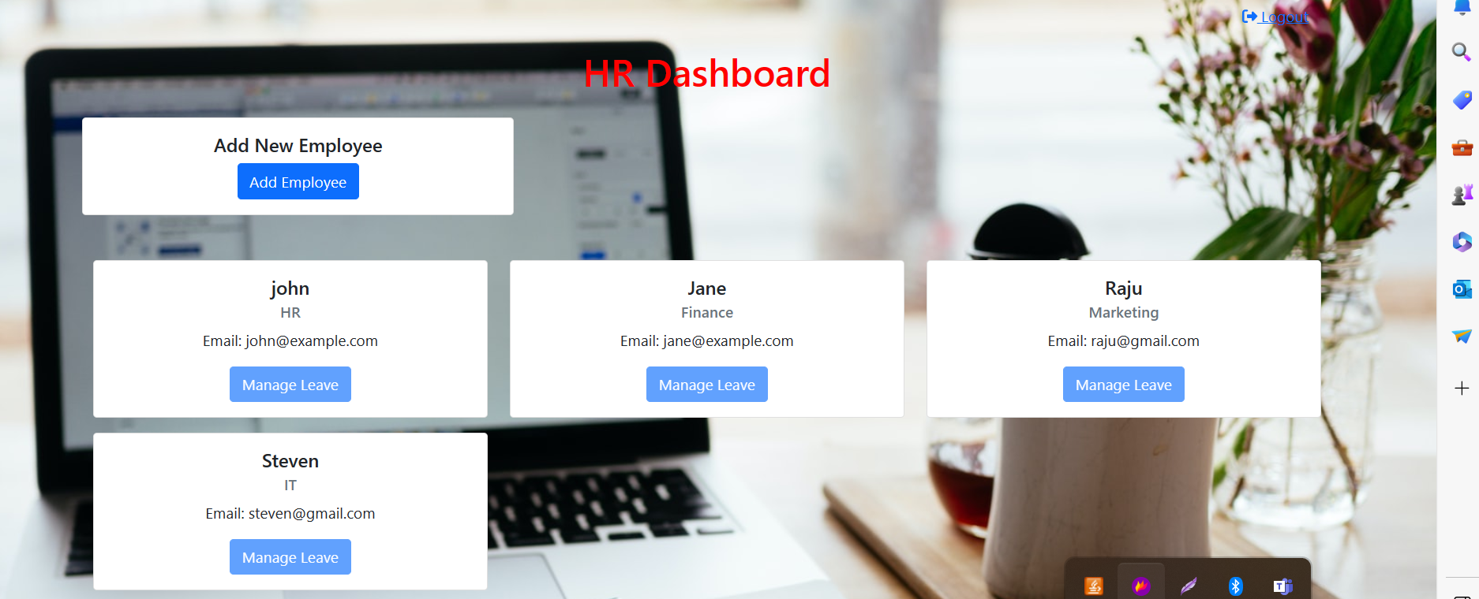
Manage leave button enable only after leave applied by employee after created account

Slide 20
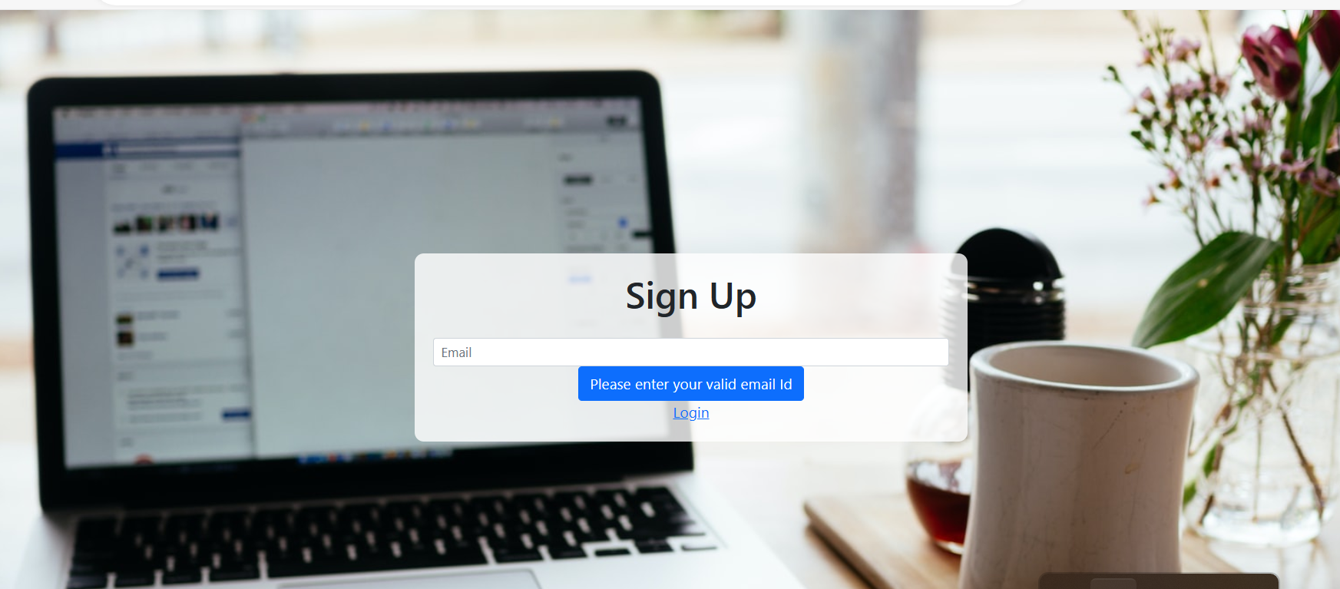
Now we will do signup with steven@gmail.com account.

Slide 21
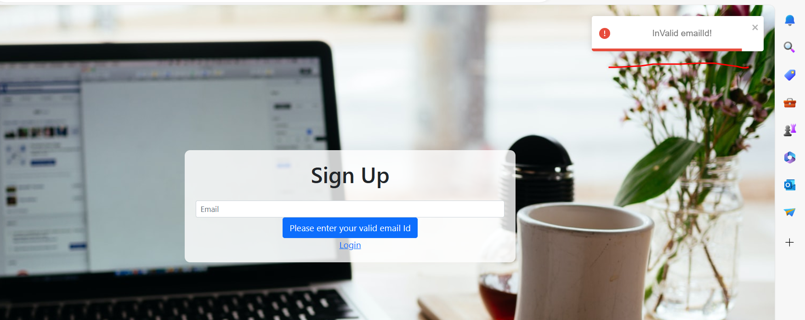
When we write wrong email id as akash@gmail.com

Slide 22
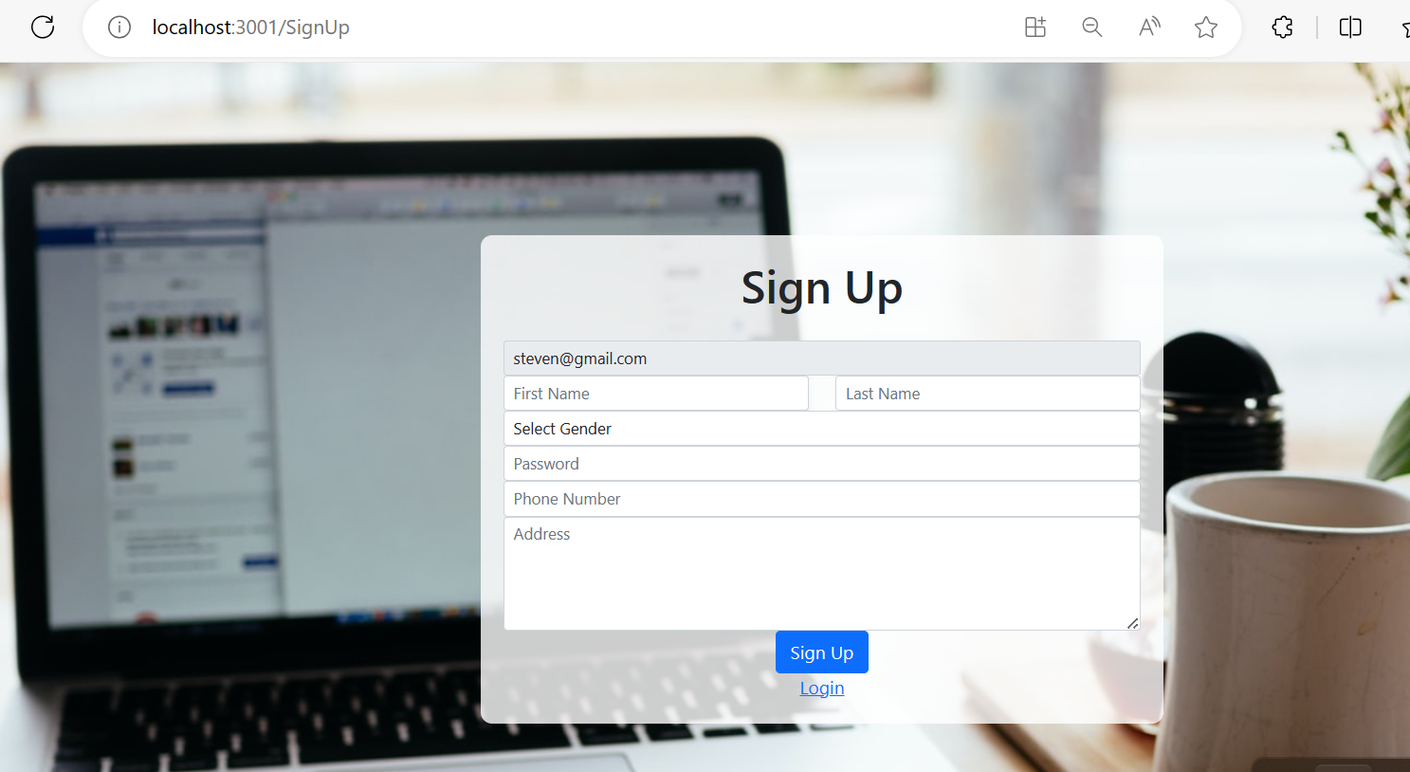
If you enter correct email id then only remaining option enable for us to create the account

Slide 23
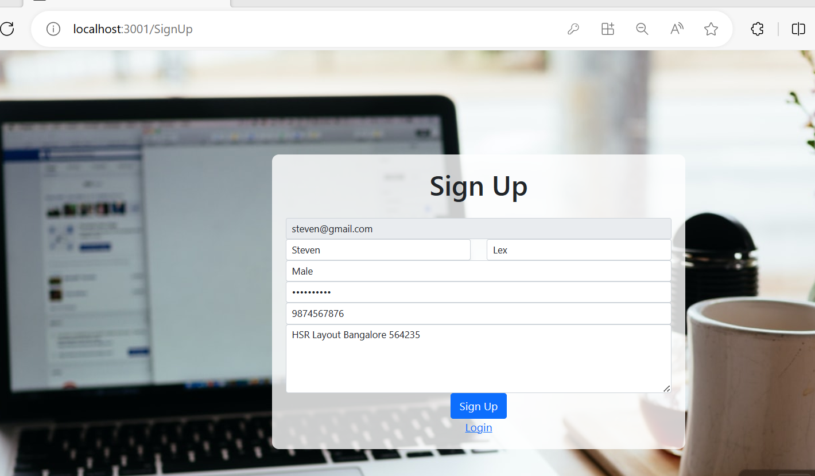
After fill all information

Slide 24
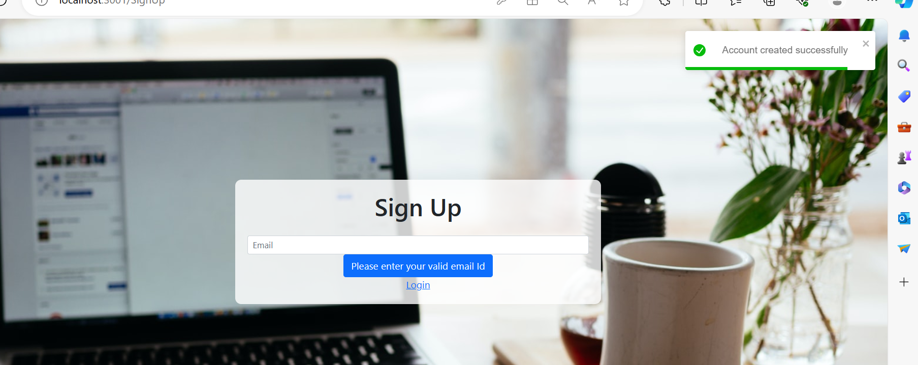

Slide 25
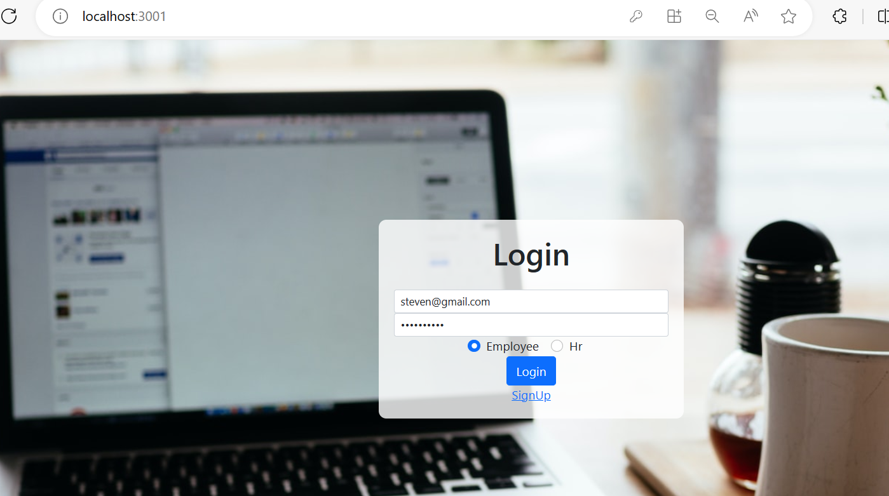
Employee can login with email id as steven@gmail.com and password as steven@123

Slide 26
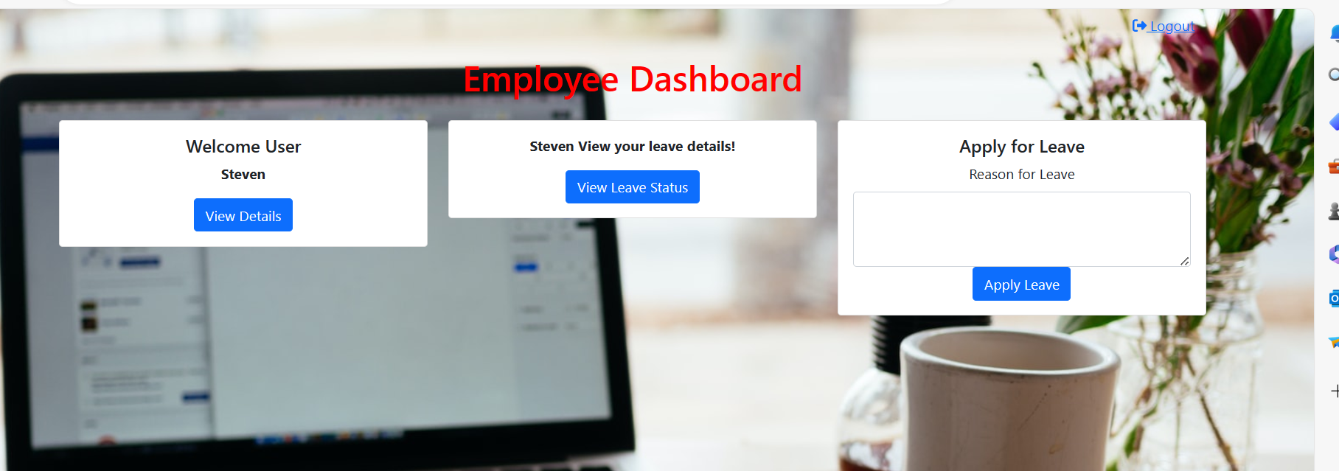
Employee dashboard

Slide 27
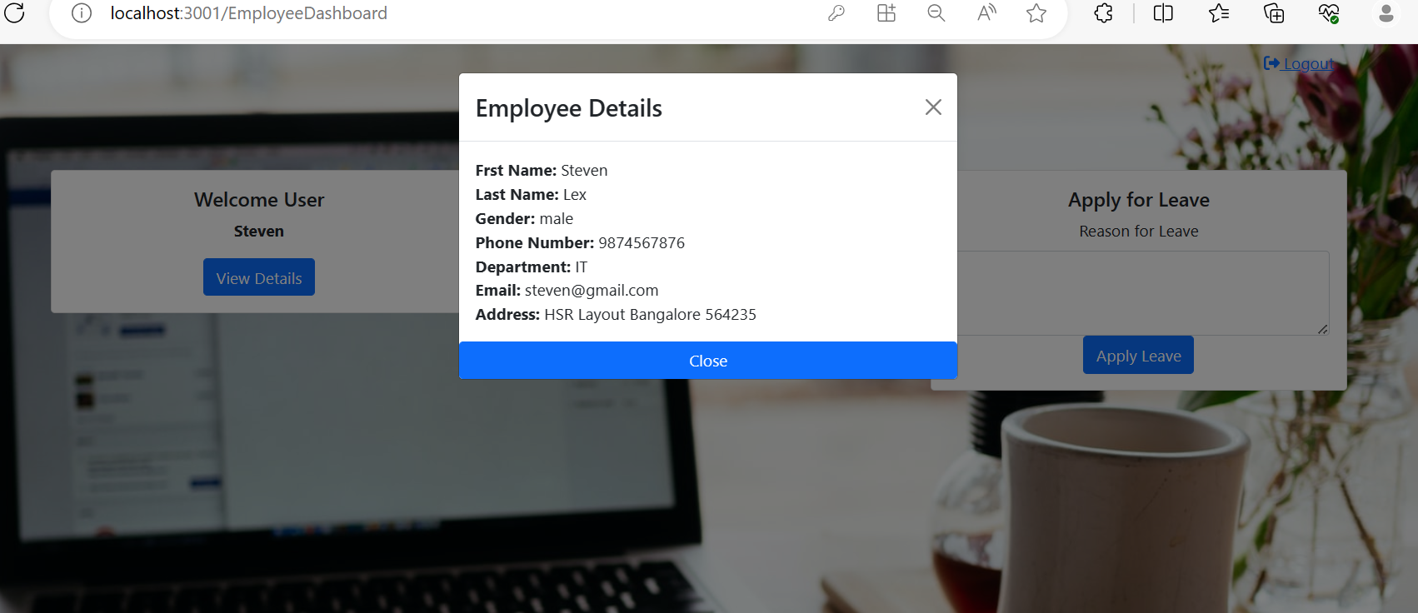
Employee can view its own details

Slide 28
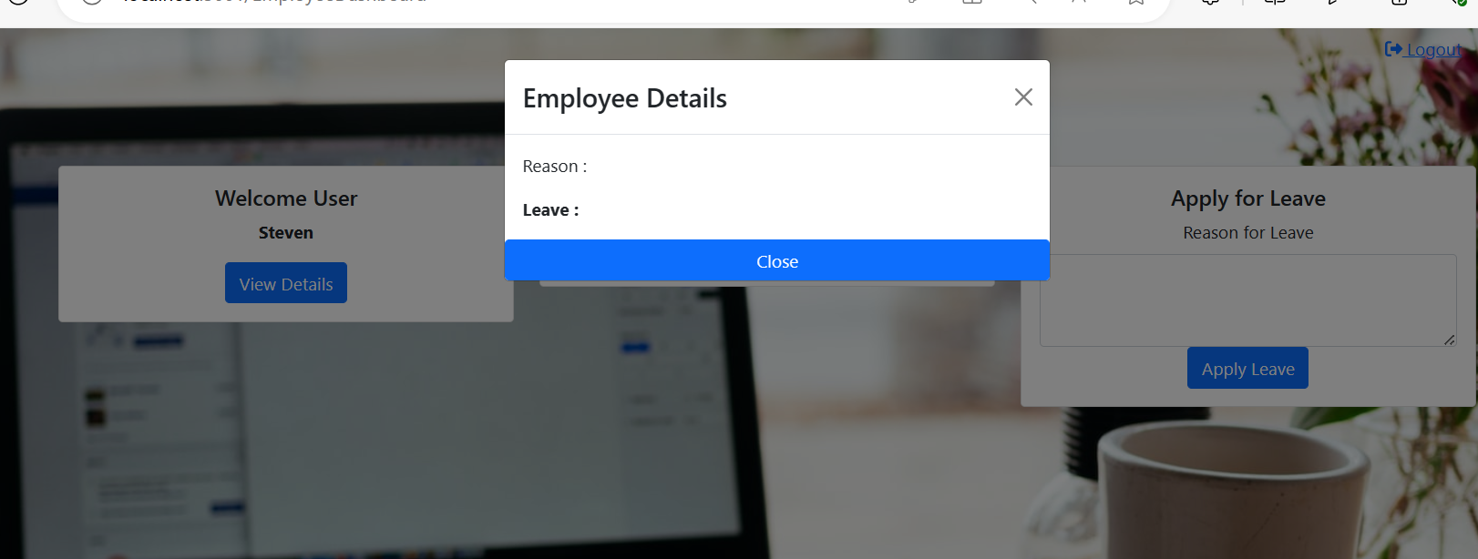
Employee can view leave details

Slide 29
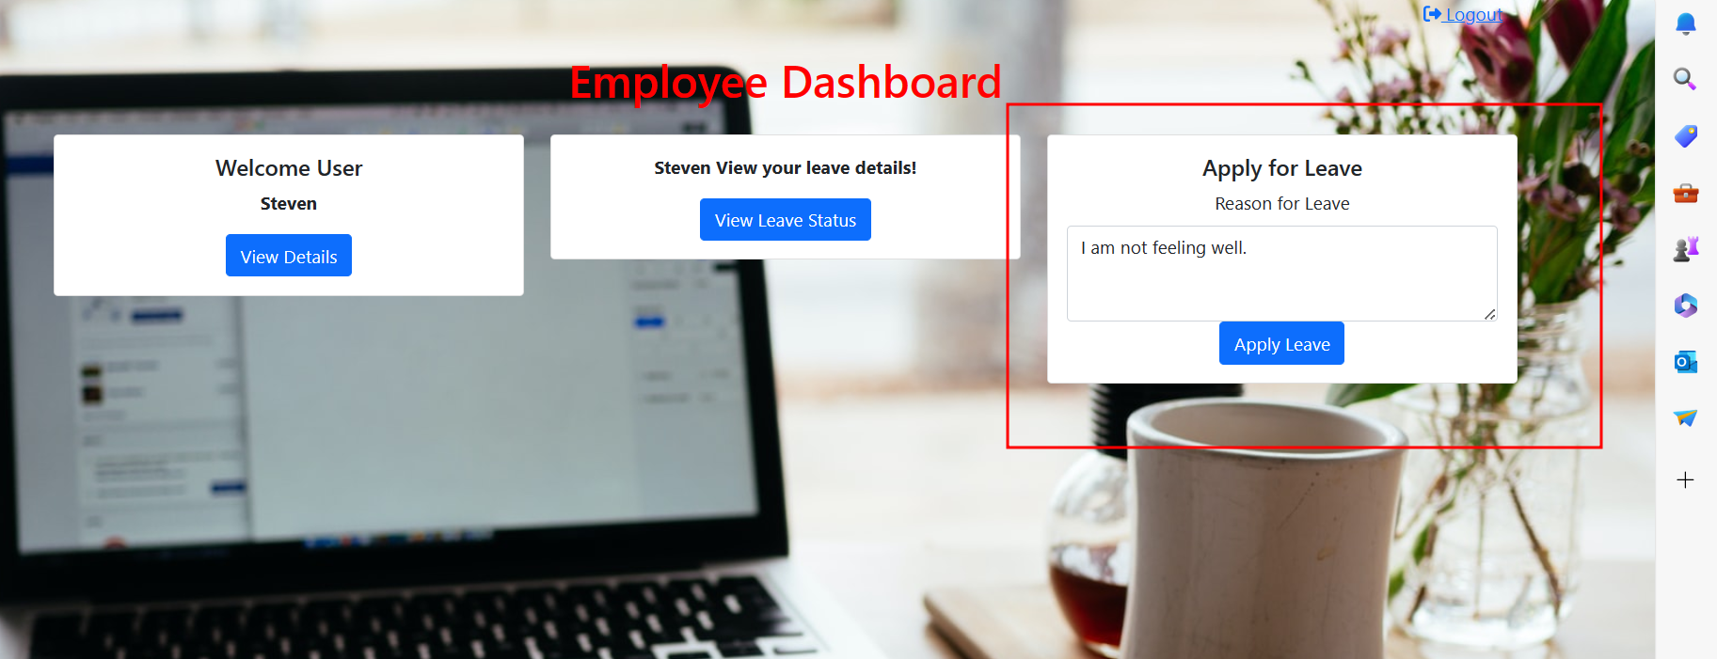
Employee can apply leave

Slide 30
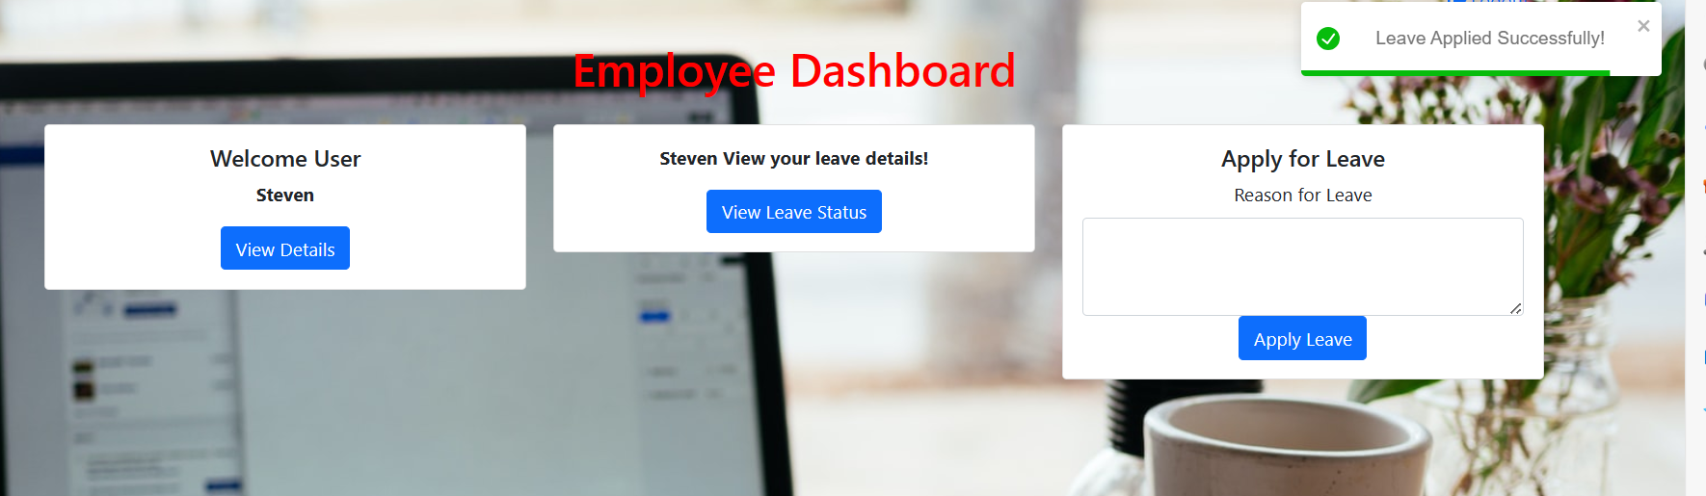
After leave applied successfully

Slide 31
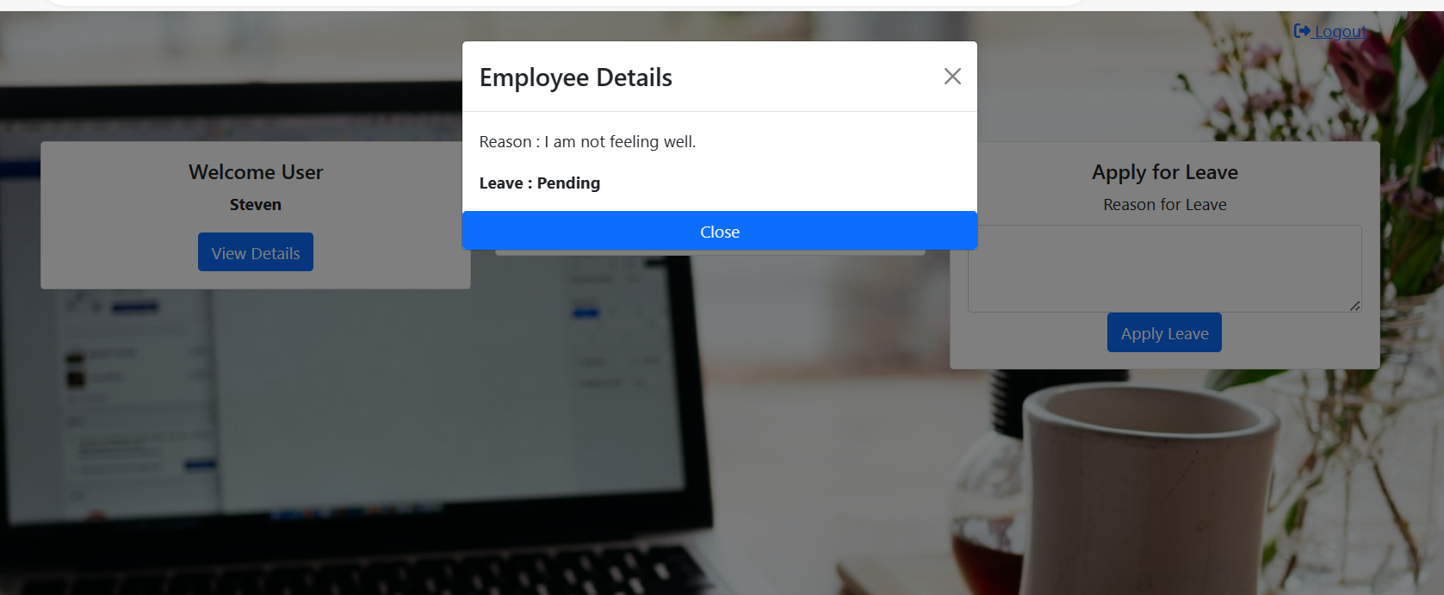
After applied leave you can see status

Slide 32
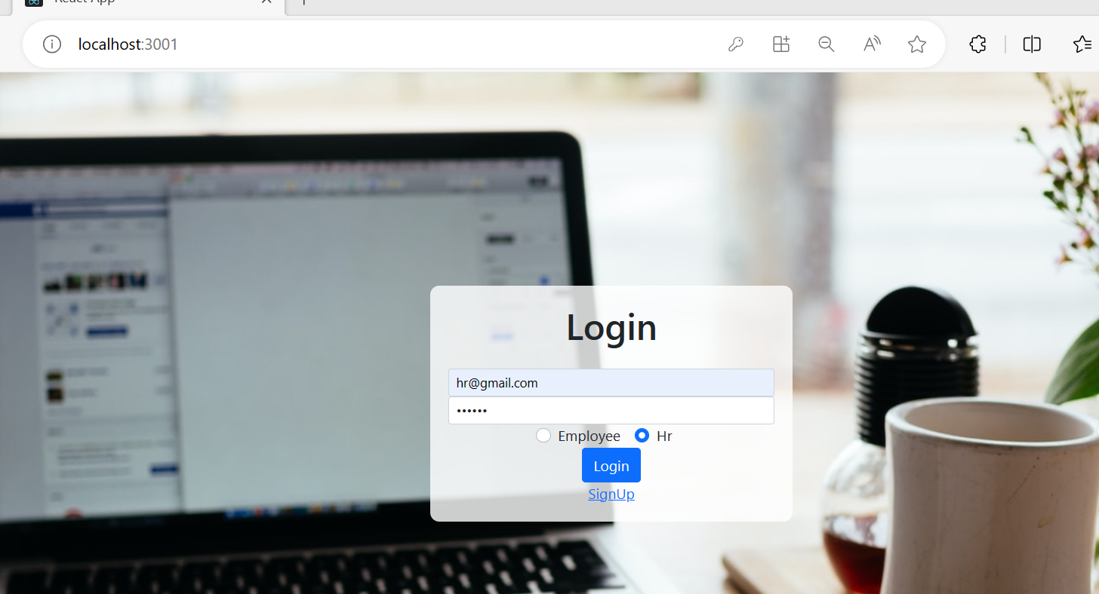
Now logout and then login for hr account

Slide 33
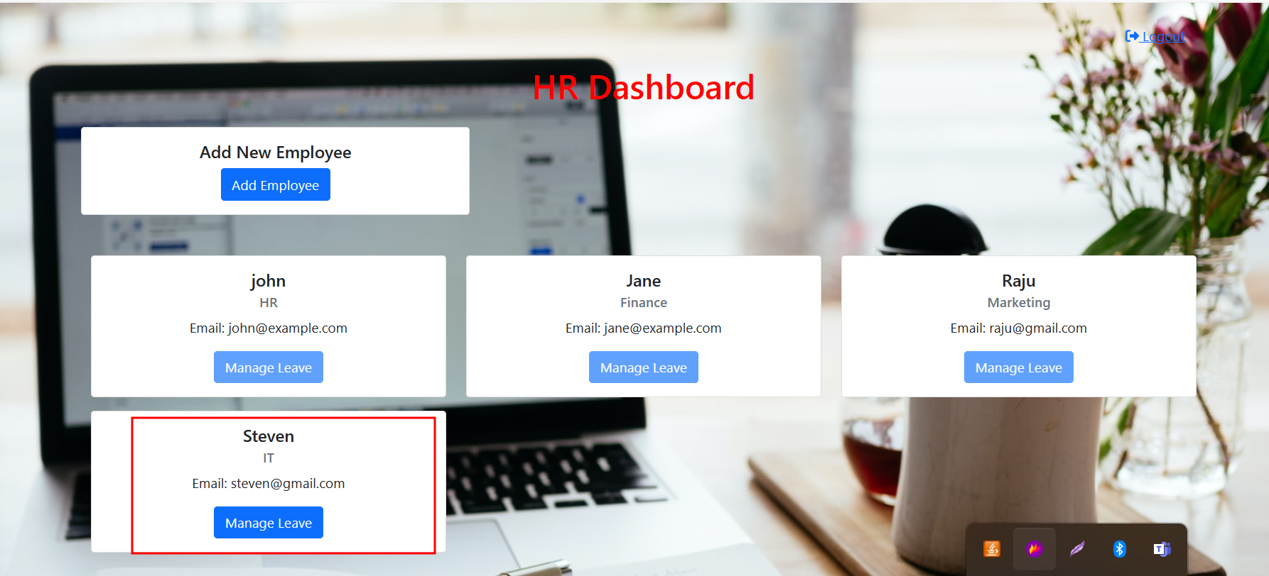
Hr dashboard

Slide 34
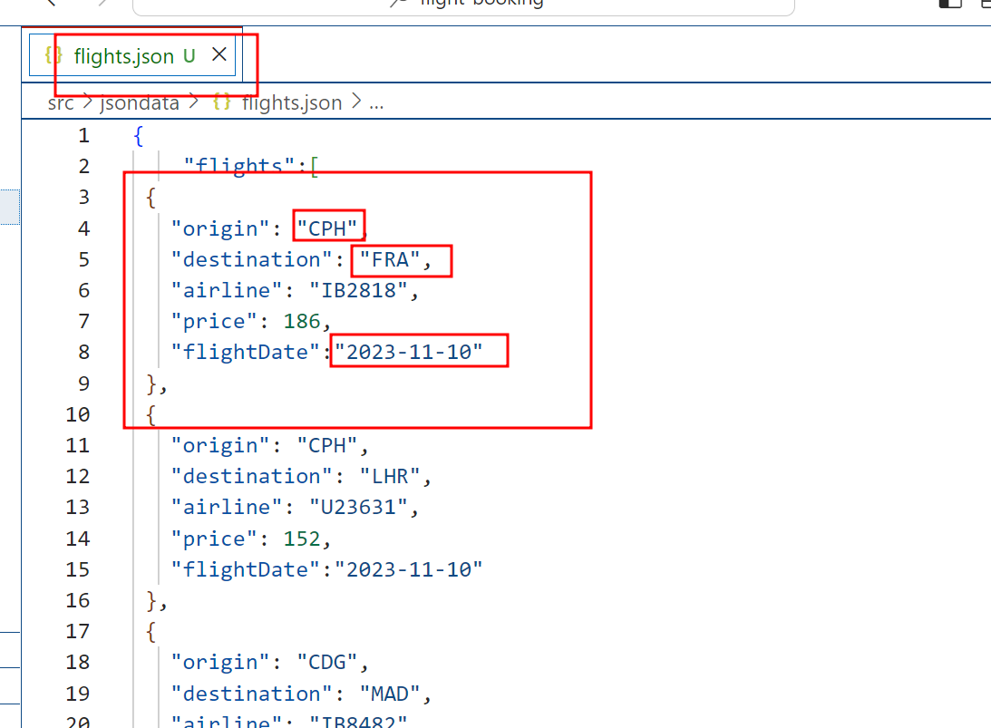

Slide 35
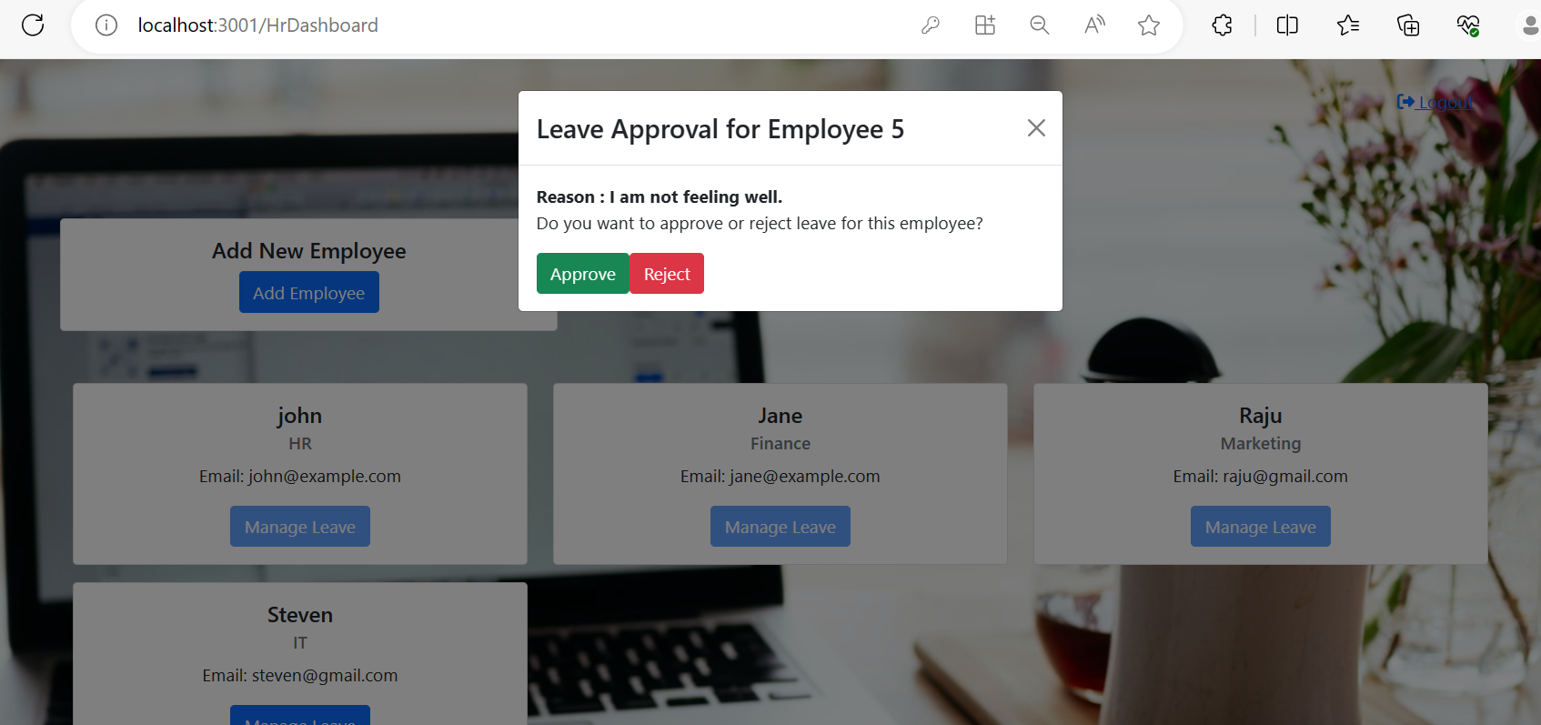
Now hr can approve and reject

Slide 36
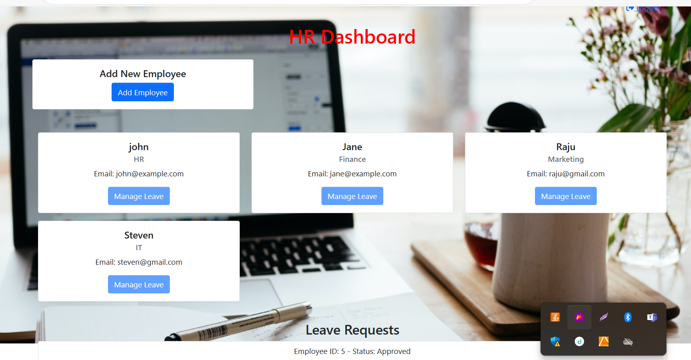
After approved

Slide 37
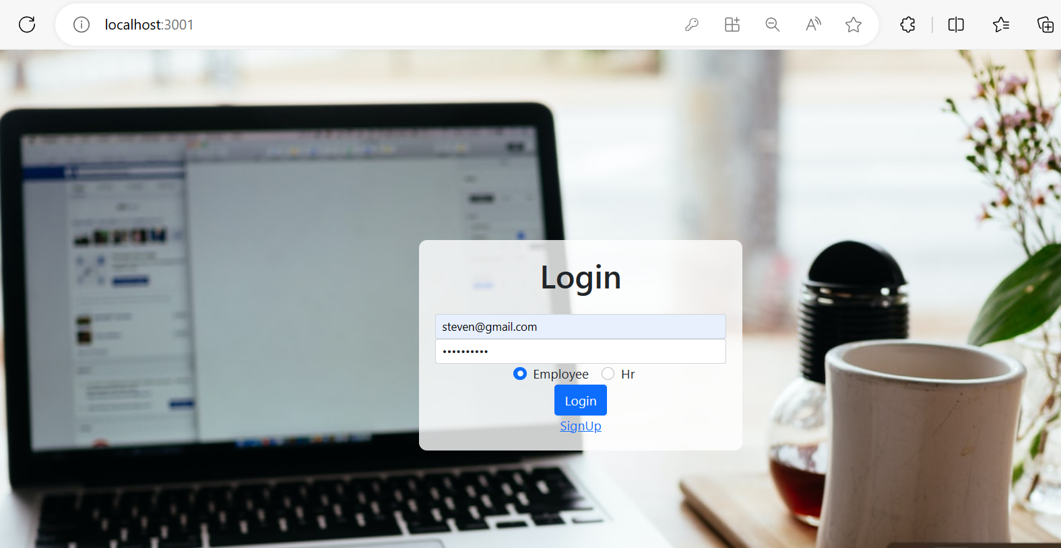
Now login from steven account and check the status

Slide 38
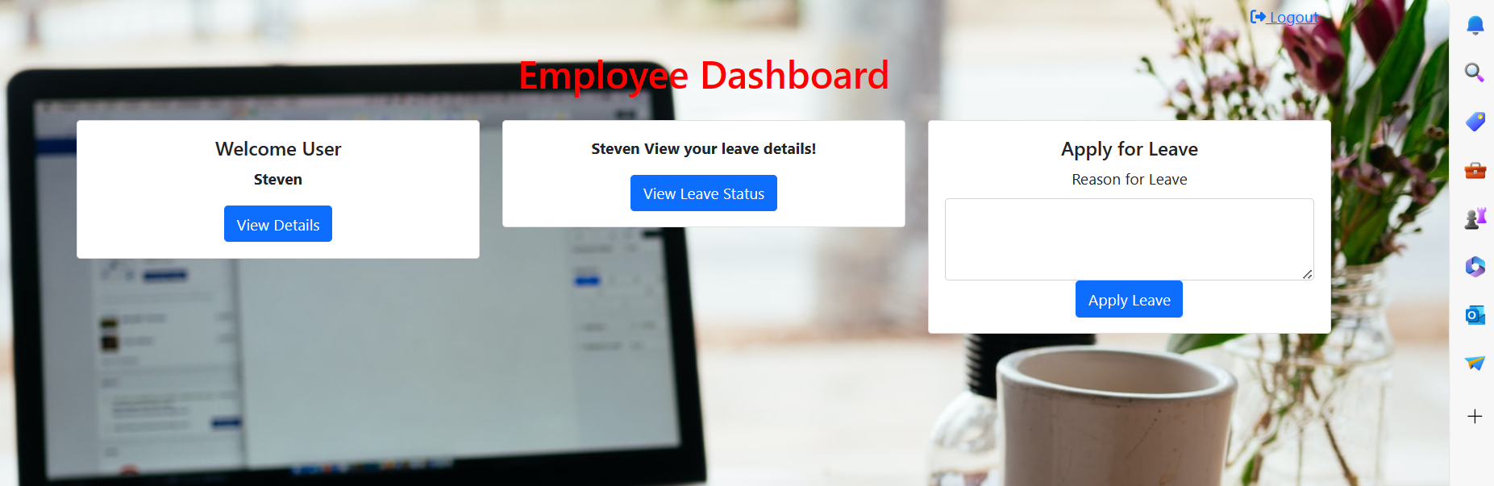
Now check the leave status

Slide 39
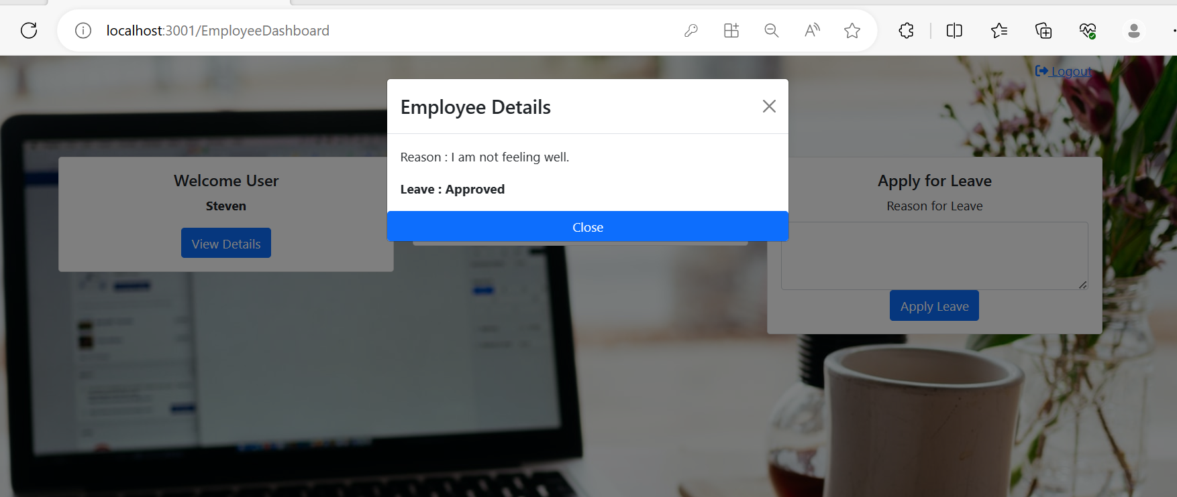
Leave status approved by hr

Slide 40
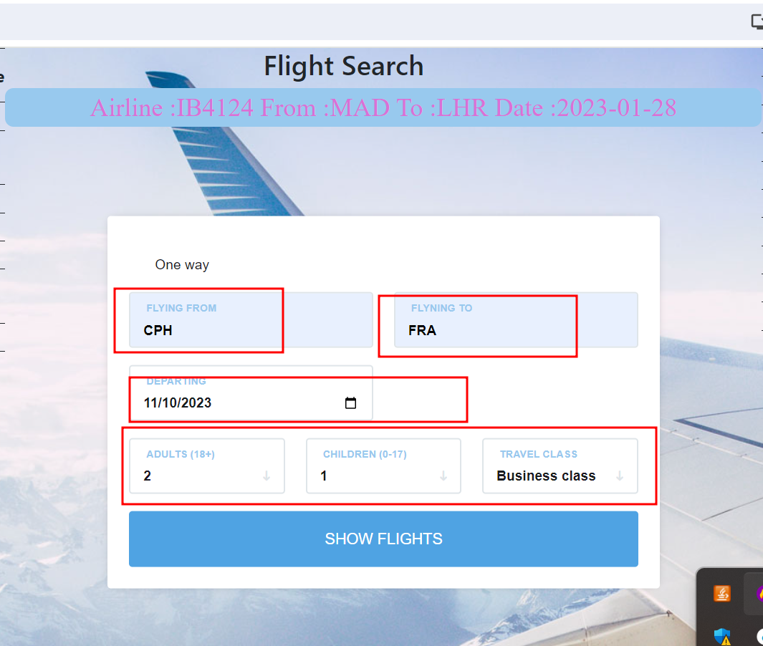

Slide 41
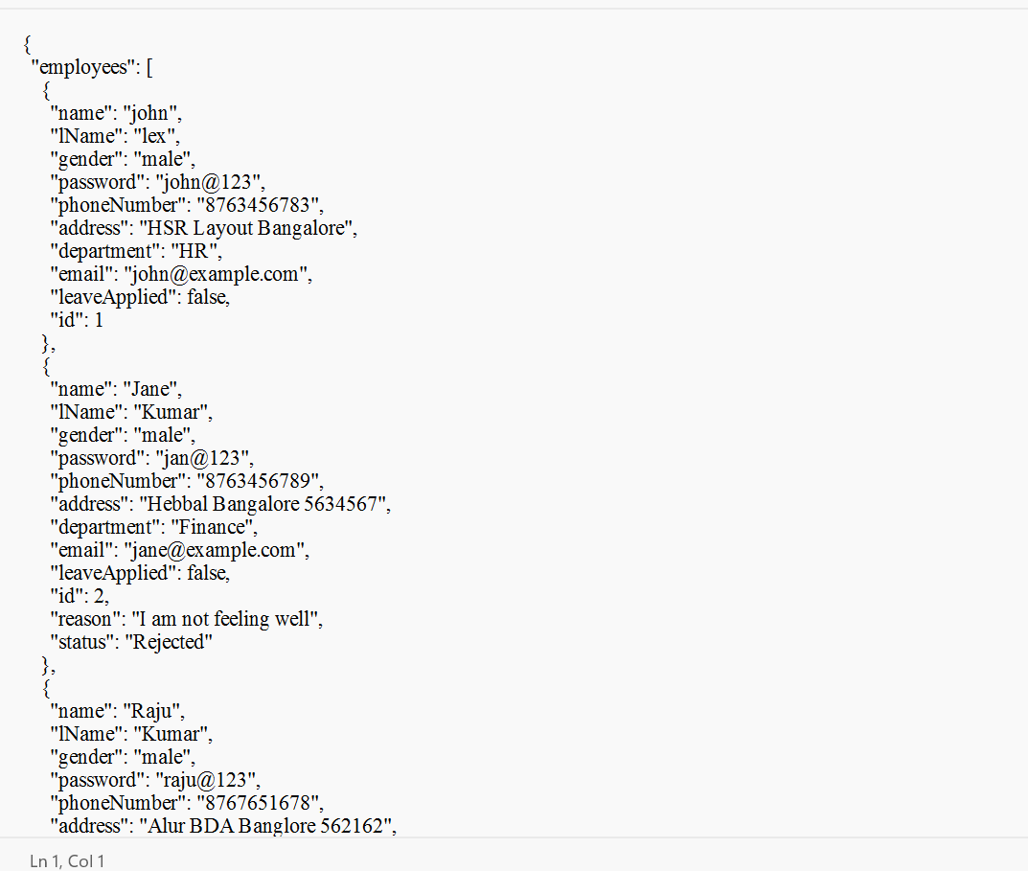
All these operation stored in hr.json file

